Slide 1


MOVIE GENRE PREDICTION BASED ON PLOT SUMMARIES
BY ZARIFF DANIAL

Slide 2


CONTENT
CURRENT STATE ANALYSIS
ABOUT ME
COURSE TIMELINE
TECHNOLOGY STACK
PROTOTYPE
PROJECT OVERVIEW
TIMELINE
PROJECT OBJECTIVE
BUDGET

Slide 3

ABOUT ME
Bachelor’s degree in Netcentric Computing from Universiti Teknologi Mara
I am a highly motivated fresh graduate with a passion for data analysis and machine learning. I am eager to contribute my skills to a dynamic team and learn from experienced professionals in the field.
My goal is to leverage data science to enhance the entertainment industry by developing accurate and efficient movie genre prediction models. I aim to contribute to improved content recommendation systems, audience targeting, and overall viewer satisfaction through the application of data-driven insights

Slide 4

COURSE TIMELINE
Data Wrangling And EDA
MONTH 1
MONTH 3
Digital Leaderhip
Introduction To Data Science And Python
MONTH 2
Machine Learning, Deep Learning And Natural Language Processing
MONTH 4

Slide 5



PROJECT OVERVIEW
Project Title: Predicting movie genre based on it’s plot
The core idea behind this model is to enhance movie recommendation systems by accurately predicting movie genres based on plot summaries.
By precisely classifying movies into their respective genres, we can significantly improve the recommendation algorithms used by streaming platforms and movie websites. This will lead to a more personalized viewing experience for users, as they will be presented with movies that align closely with their preferences.

Slide 6

PROJECT OBJECTIVE
Develop an automated genre classification model
2. Enhance user experience
3. Improve content management
Create a machine learning model capable of accurately assigning a single primary genre to a movie based on its content.
Improve the user experience in streaming services and recommendation systems by providing more accurate and relevant genre classifications.
Streamline the process of content organization and management in the film industry through efficient and consistent genre classification.

Slide 7




CURRENT STATE ANALYSIS
Complexity of plot summaries
Overlapping genres
Limited training data

Slide 8

TECHNOLOGY STACK
Python
Pandas
Scikit-learn
Natural Language Toolkit (NLTK)
Jupyter Notebook
Flask

Slide 9

INTERACTIVE PROTOTYPE USING PYTHON PROGRAMMING

Slide 10
TIMELINE
Items | March -24 | April – 24 | May - 24 | Jun - 24 | July - 24 | August - 24
Business Understanding
Analytics Approach
Data Requirements
Data Collection
Data Understanding
Data Preparation
Modelling
Evaluation
Deployment
Feedback

Slide 11


BUDGET
Cost Component Personnel Costs
Description
Data Scientist/Machine Learning Engineer (1 year)
Data Analyst (1 year)
Software Engineer (1 year)
Cloud Platform
Hardware (if required)
Data Licensing (if applicable)
Data Cleaning and Preprocessing
Software and Tools
Initial Deployment
Ongoing Maintenance (per year)
Cost (RM)
60,000 - 80,000 40,000 - 60,000 40,000 - 60,000 11,000
20,000
5,000 - 10,000 10,000
5,000
5,000 - 10,000 5,000
21,000 - 30,000 217,000 - 305,000
Infrastructure and Computational Resources
Data Acquisition and Preprocessing
Model Development and Evaluation Deployment and Maintenance
Contingency (10% of Total Budget) Total Project Budget

Slide 12

CONCLUSION
In a nutshell, this model is used to predict movie genres accurately based on plot summaries.
Increase the efficiency of content recommendation systems by providing relevant movie suggestions to users.
In the near future, the model can be expanded to include other movie metadata (e.g., cast, director, keywords) to further enhance prediction accuracy.
Next stage of modeling will focus on real-time genre prediction for newly released movies and explore the use of deep learning architectures for improved performance.

Slide 13


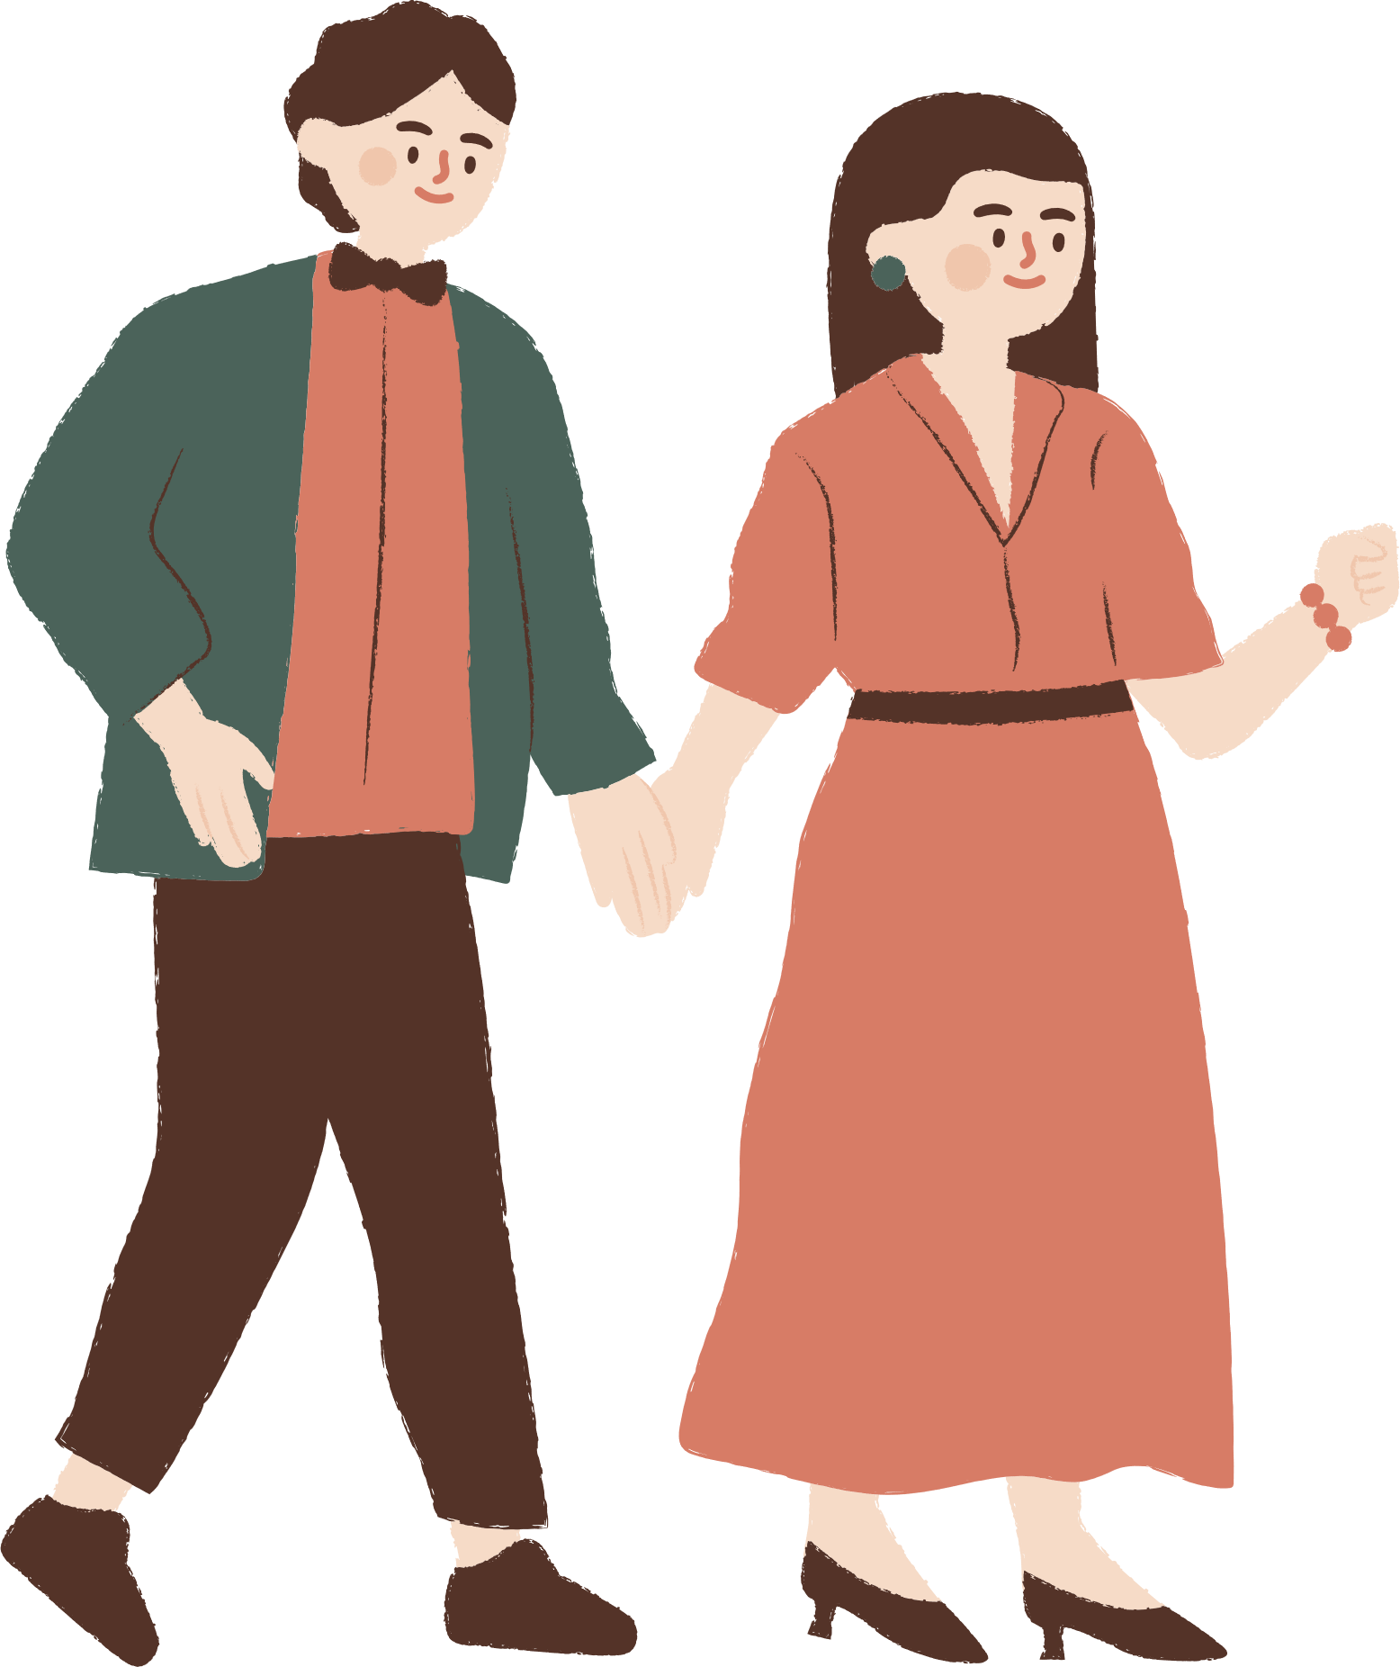

THANK YOU FOR LISTENING
Don't hesitate to ask any questions!

